Slide 1


Bank Loan of Customers
Project No. 60
Group No. : 1
Let's Get Started
Group Members:
1.Swaraj Vijaykumar Abruk
2.Saurabh Prakash Patil
3.Shubham Vilas Dhavan
4.Ojas Arun Patil
5.Monika Ravindra Sonawane
6.Hrutuja Shivaji Mohangekar

Slide 2



Agenda
Project KPI's
PROJECT INTRODUCTION
Summary
Project Overview

Slide 3
Project Introduction
The Project of “Bank Loan of Customers is under the domain of Finance, where we have given 2 Types of Dataset one is in csv format and another is in xlsm format.
The aim of the project is to solve the KPI’s and analyse the growth that the bank achieved in given years.

Slide 4


Project Overview
KPI 1: Year wise loan amount Stats
KPI-2 : Grade and sub grade wise revol_bal
KPI-3 : Total Payment for Verified Status Vs Total Payment for Non Verified Status
KPI-4 : State wise and last_credit_pull_d wise loan status
KPI-5 : Home ownership Vs last payment date stats

Slide 5
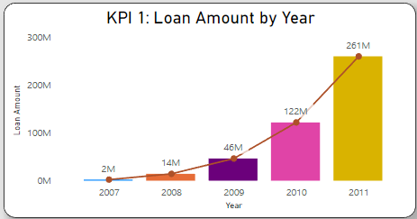



KPI 1: Year wise loan amount Stats
In KPI 1, we have to show the loan amount by year, in which we can observe that it is continuously rising.
In 2007, the loan amount was 2 million and in 2011, it went to 261 million.
The amount of the loan has increased by 259 million in 4 years.

Slide 6
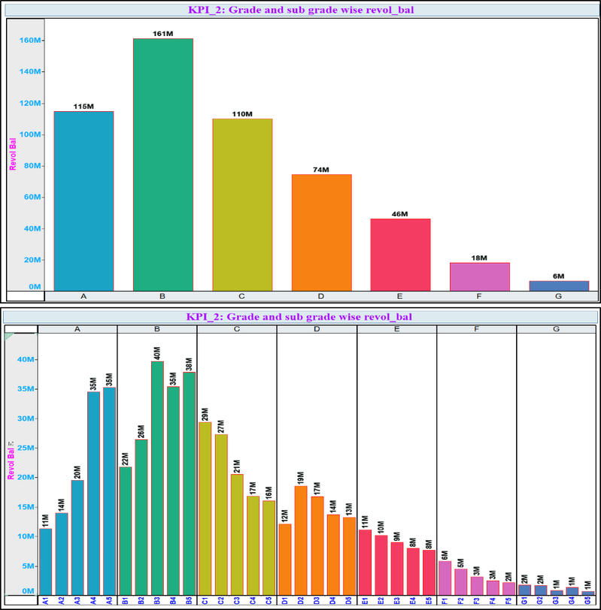
KPI-2 : Grade and sub grade wise revol_bal
In KPI 2, we have to visualise the revolving balance by grade and sub-grade.
We can observe that Grade A has a 115 million revolving balance, while Grade B has 161 million, which is the highest value; Grade C has 110 million, Grade D has 74 million, Grade E has 46 million, Grade F has 18 million, and Grade G has the lowest revolving balance, which is 6 million.
Here, Grade B has the highest revolving balance and Grade G has the lowest revolving balance.

Slide 7

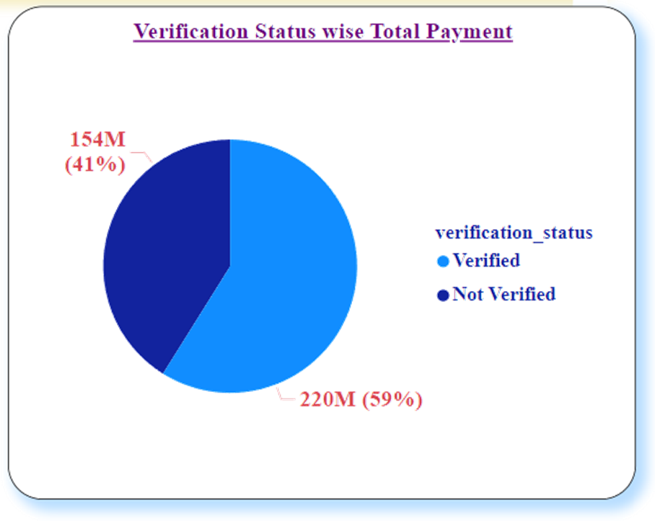
KPI-3 : Total Payment for Verified Status Vs Total Payment for Non Verified Status
In KPI 3, we have to delineate the total payment of verified users and non-verified users.
There are 219.89 million verified users (45.55%) and 153.54 million non-verified users (31.81%).

Slide 8

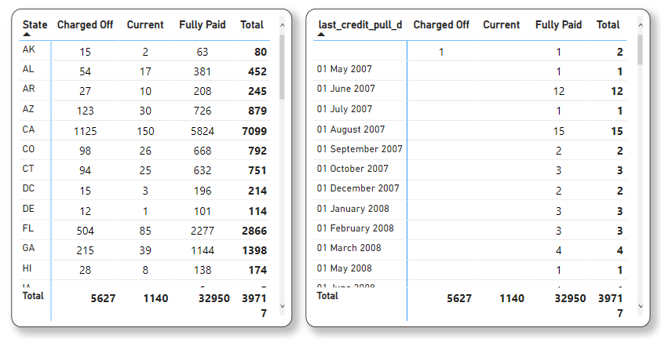
KPI-4 : State wise and last_credit_pull_d wise loan status
In KPI 4, we have to display loan status by state and last credited pull date.
The count of loan status for charged off is 5627, current is 1140, and fully paid is 32950.
In which the total count is 39717.
For May 2016, the total count was 10308, which is the highest, and the highest count is 7099 for California

Slide 9


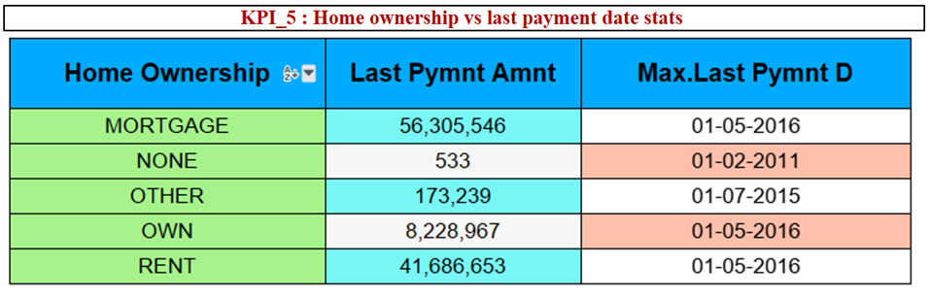
KPI-5 : Home ownership Vs last payment date stats
In KPI 5, we have to observe the latest payment date for home ownership.
Here we can see that the last date for payment of the mortgage is May 2016 and the paid amount is 56.30 million. For rent is May 2016 where the paid amount is 8.22 million and for rent is also May 2016 and the paid amount is 41.68 million.

Slide 10


